Slide 1
TERM PROJECT
Victor Penev 12 A

Slide 2
PROJECT ASSIGNMENT
Develop an “Empty box detection system”. The system must monitor the weight of the boxes on a conveyor belt. If the box weight is not between X kg and Y kg, the conveyor belt must be stopped, and a sound indication must be activated. The X and Y values are sent from an internet server and the values can be between 0-2kg. The factory has many conveyor belts and there is no cabling aside from power to them.

Slide 3
REQUIREMENTS – SENSORS
ACTUATORS
Analyze the necessary sensors and actuators. For each controlled/monitored value, select a minimum of three sensors / actuators from well-known manufacturers. Choose one of them and justify your choice based on range, sensitivity, speed, price, and operating conditions.
Develop an “Empty box detection system”. The system must monitor the weight of the boxes on a conveyor belt. If the box weight is not between X kg and Y kg, the conveyor belt must be stopped, and a sound indication must be activated. The X and Y values are sent from an internet server and the values can be between 0-2kg. The factory has many conveyor belts and there is no cabling aside from power to them.
Asked questions that support those requirement:
1. Should the sensors measure weights strictly between 0–2 kg, or is there a tolerance range (±5%)?
+/-5% is an acceptable tolerance
2. What kind of audible indication is required and what should the volume be?
The production lines are in a large room (2000 sq m) and the sound should be loud enough to be heard in an industrial environment. The study is part of the task
3. Are there any specific environmental conditions for the sensors and actuators?
The temperature in the hall can reach 45 degrees. There are no other specific requirements

Slide 4
REQUIREMENTS – MCU
Analyze the right MCU. Select a minimum of three MCUs from well-known manufacturers. Choose one of them and justify your choice based on performance, price, interfaces, power consumption, operating conditions.
Develop an “Empty box detection system”. The system must monitor the weight of the boxes on a conveyor belt. If the box weight is not between X kg and Y kg, the conveyor belt must be stopped, and a sound indication must be activated. The X and Y values are sent from an internet server and the values can be between 0-2kg. The factory has many conveyor belts and there is no cabling aside from power to them.
Asked questions that support those requirement:
1. Are there any specific environmental conditions for the sensors and actuators?
The temperature in the hall can reach 45 degrees. There are no other specific requirements

Slide 5
REQUIREMENTS – PSU
Analyze PSU. Choose a minimum of three PSU solutions from well-known manufacturers. Choose one of them and justify your choice based on the number and values of the output voltages, maximum current, efficiency, price, and operating conditions.
Develop an “Empty box detection system”. The system must monitor the weight of the boxes on a conveyor belt. If the box weight is not between X kg and Y kg, the conveyor belt must be stopped, and a sound indication must be activated. The X and Y values are sent from an internet server and the values can be between 0-2kg. The factory has many conveyor belts and there is no cabling aside from power to them.
Asked questions that support those requirements:
1. Should it be possible to determine the working capacity of the factory or should it always work at 100% and all conveyor belts (will all belts always work or can we turn off and on the belts individually, which will mean different PSU connections, and/or possibly a turn off button to turn off this belt)
Each belt should be able to be stopped individually.

Slide 6
REQUIREMENTS – COMMUNICATION
Analyze the communication between the designed IoT device and the Internet. Choose a specific wired / wireless protocol for communication based on speed, range, consumption, and price. Select a specific transceiver solution from a well-known manufacturer, implementing the relevant protocol.
Develop an “Empty box detection system”. The system must monitor the weight of the boxes on a conveyor belt. If the box weight is not between X kg and Y kg, the conveyor belt must be stopped, and a sound indication must be activated. The X and Y values are sent from an internet server and the values can be between 0-2kg. The factory has many conveyor belts and there is no cabling aside from power to them
Asked questions that support those requirement:
1. Should the system send data continuously or only on certain events (if a box exceeds/does not meet weight limits)?
Only in case of an event. Plus sporadic information that the system is working
2. Is there any specific factory layout or environmental factor that we need to consider in order to know how the different components should be connected?
The production lines are evenly spaced in an open space of 2000 sq m.
3. Is it okay to send sporadic I'm alive messages every 1 hour or should they be sent more frequently?
Maximum every 5 minutes

Slide 7
PROJECT BLOCK DIAGRAM

Slide 8
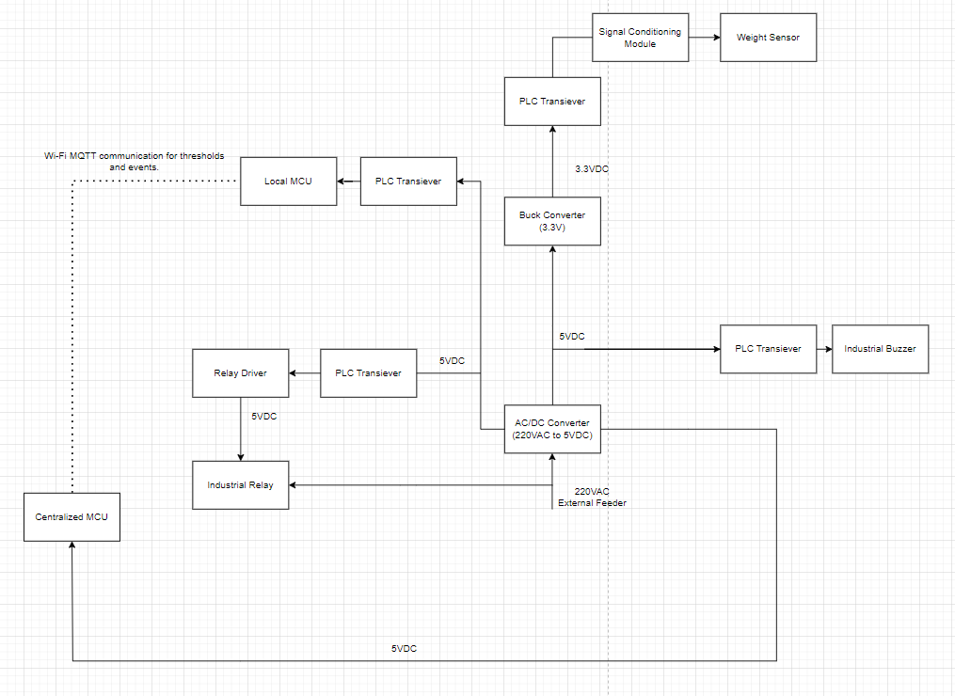

Slide 9
COMPONENTS - PSU
Chosen PSU - IRM-10-5(https://www.digikey.bg/en/products/detail/mean-well-usa-inc/IRM-10-5/7704657) - 6.91€

Slide 10
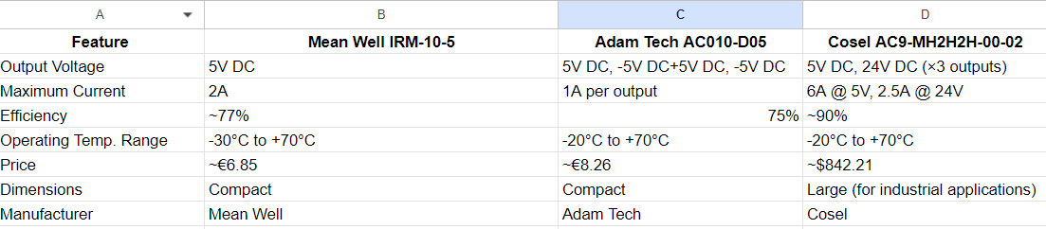
COMPONENTS - PSU (COMPARISON)
https://www.digikey.bg/en/products/detail/adam-tech/AC010-D05/22469409
https://www.digikey.bg/en/products/detail/cosel-usa-inc/AC9-MH2H2H-00-02/7052740

Slide 11
COMPONENTS - BUZZER
Criteria for searching:
need to cover 2000 sq. m (meaning that it must be more than 100 db per 1 meter)
Operating temperature could get as high as +45 C
Chosen buzzer - XL-5530-LW300-S-R (https://www.digikey.bg/en/products/detail/pui-audio-inc/XL-5530-LW300-S-R/1745724) - 21.21€

Slide 12
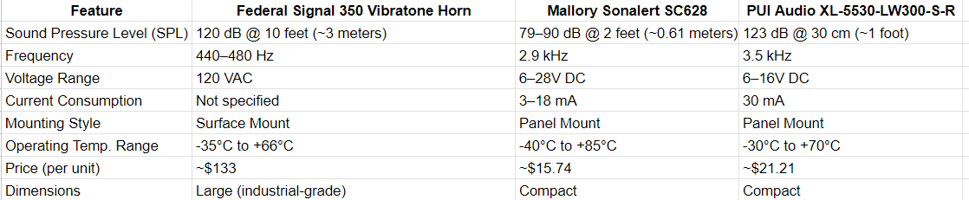
COMPONENTS - BUZZER (COMPARISON)
https://signaling.fedsig.com/product/350-vibratone-horn
https://www.digikey.bg/en/products/detail/mallory-sonalert-products-inc/SC628/528117

Slide 13
COMPONENTS - MCU
Criteria of searching:
Support Wi-Fi communication
Operate reliably at temperatures up to 45°C
Are manufactured by reputable companies
Chosen MCU - ESP32(https://www.digikey.bg/en/products/detail/espressif-systems/ESP32-S3/15822445) - 1.92$

Slide 14
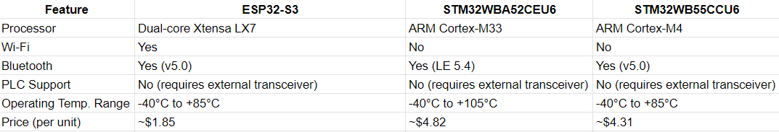
COMPONENTS - MCU (COMPARISON)

Slide 15
COMPONENTS - Weight Sensor
Criteria of searching:
must weight minimum of 2 kg
could be digital or analog but with signal conditioning module\
must be single point load cell
Operating temperature could get up to +45C
±5% maximum accuracy
Chosen weight sensor - H07A (https://www.bosche.eu/en/p/miniature-load-cell-h07a/100-300-50-04) - 54.02$
Needs to be used with combination of a signal conditioning module (SparkFun Load Cell Amplifier - HX711 - (https://www.sparkfun.com/products/13879) - 10.95$) to convert the analog signal to a format compatible with your PLC transceiver.

Slide 16
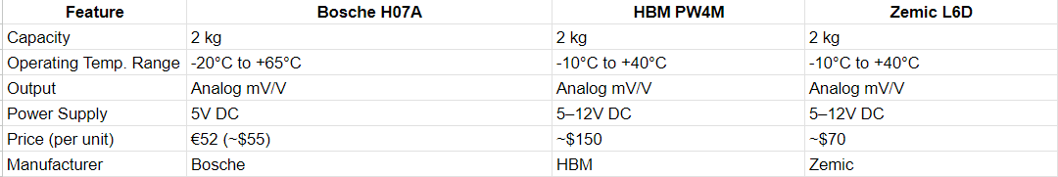
COMPONENTS - Weight Sensor (COMPARISON)

Slide 17
OTHER COMPONENTS
Relay - G2R-1-E DC24 (https://www.digikey.bg/en/products/detail/omron-electronics-inc-emc-div/G2R-1-E-DC24/154284) - - 7.17$
Relay Motor - LRD12 (https://www.digikey.bg/en/products/detail/schneider-electric/LRD12/22033825) - 75.69$
PLC Transceiver x4 - MAX14850ASE+(https://www.digikey.bg/en/products/detail/analog-devices-inc-maxim-integrated/MAX14850ASE/3517194) - 4.93$
Buck Converter - TPSM82903SISR (https://www.digikey.it/en/products/detail/texas-instruments/TPSM82903SISR/17748443?srsltid=AfmBOorqAk9l90UXkexv_PXPGEHMxSSx0XyEHMhqoAFmMlsZskvim2zH) - 3.83$
Signal Conditioning Module - 1176030000(https://www.digikey.de/de/products/detail/weidmüller/1176030000/3993861?srsltid=AfmBOoqGYGqSP_-3mLSjOaYqF5rsjMWPvGhKj66qLcPU1dCT8Nat1TPX) - 343.90$

Slide 18
Price Analysis
For one conveyor belt - 545.11 $
For 50 conveyor belts - 27,255.5 $
For the whole system - 27,257.42 $

Slide 19
Communication protocols and models
Using Zigbee for several reasons:
supports hundreds to thousand devices
designed for low-power devices
typically has a range of 10–20 meters per hop in industrial environments. With mesh networking, you can extend this range significantly.
Zigbee (ZCL or proprietary commands).
Zigbee Gateway - https://solsta.co.uk/product/digi-xbee-gateway/ - 134$
Acts as the translator between Zigbee and HTTP/HTTPS.
Zigbee Communication (Local):
HTTP/HTTPS Communication (Global):

Slide 20
Scheme of communication

Slide 21
